Slide 1



Mentoring & Support Microsoft 365 Copilot
Exploring training and mentoring strategies
Notes:
In this presentation, we will explore the mentoring and support mechanisms associated with Microsoft 365 Copilot. Our focus will be on training objectives, the role of mentors, and effective strategies to leverage technology for organizational enablement.

Slide 2
Introduction & Objectives
Notes:
This section covers the overall goals of the training program. We will discuss the agenda for today's session and the objectives aimed at enabling participants to trust and effectively practice with Microsoft 365 Copilot.

Slide 3


Agenda Overview
Understanding the Mentor's Role
The first block focuses on the vital role mentors play in guiding and supporting individuals in their development.
Building Trust and Leadership
The second block emphasizes the importance of trust and leadership skills in the context of the AI era to foster collaboration.
Training and Support Strategies
The final block explores effective training and support strategies for utilizing Microsoft 365 Copilot for better productivity.
Notes:
This training is designed to empower participants by enhancing their confidence in utilizing Microsoft 365 Copilot.
By focusing on enablement, we aim to ensure that everyone feels capable and ready to leverage this technology effectively.
Trust is another critical component; we will emphasize the reliability and advantages of Microsoft 365 Copilot, helping participants feel secure in their use of the tool.
Additionally, hands-on practice is essential for reinforcing learning. Participants will engage in practical exercises that allow them to apply what they've learned in real-world scenarios, solidifying their understanding and skills.
The collaborative environment depicted in the image on the left underscores the importance of teamwork in this learning journey.
the sections of the training is all about empowering participants by not only teaching them the functionality of Microsoft 365 Copilot, but also by building confidence and trust in applying it meaningfully in their daily work.
🔹 Building Trust in Technology
We understand that adopting new technologies can bring uncertainty. That’s why we focus on building trust — by showing how reliable, secure, and supportive Copilot is in real-life business scenarios.
When users feel that the technology works with them rather than replacing them, adoption becomes natural.
🔹 Hands-On Practice Opportunities
Confidence is best built through experience. That’s why this training includes guided, hands-on practice, where participants interact with Copilot in common workflows like:
Drafting documents and emails
Generating reports in Excel
Preparing presentations with PowerPoint
Summarizing meeting notes in Teams
These exercises are based on real-world use cases, helping learners connect theory to practice.
🔹 Empowerment Through Enablement
Ultimately, enablement is not just about instruction — it’s about empowerment.
We want participants to leave this session feeling not only trained, but capable and motivated to use Copilot to improve productivity, creativity, and collaboration in their teams.
Would you like a visual layout suggestion or a demo script aligned with this message?

Slide 4

Training Objective: Enablement, Trust, Practice
Empowerment Through Enablement
This training aims to empower participants by building their confidence in using Microsoft 365 Copilot effectively.
Building Trust in Technology
We focus on fostering trust in new technologies, emphasizing the reliability and benefits of Microsoft 365 Copilot.
Hands-On Practice Opportunities
Participants will have ample opportunities for hands-on practice, reinforcing their learning through real-world application.
Notes:
This training is designed to empower participants by enhancing their confidence in utilizing Microsoft 365 Copilot.
By focusing on enablement, we aim to ensure that everyone feels capable and ready to leverage this technology effectively.
Trust is another critical component; we will emphasize the reliability and advantages of Microsoft 365 Copilot, helping participants feel secure in their use of the tool.
Additionally, hands-on practice is essential for reinforcing learning. Participants will engage in practical exercises that allow them to apply what they've learned in real-world scenarios, solidifying their understanding and skills.
The collaborative environment depicted in the image on the left underscores the importance of teamwork in this learning journey.

Slide 5
Key Takeaways
Leverage AI to transform your organization and enhance employee experience.
View AI as a tool to boost creativity, productivity, and skill development among employees.
Offer personalized information to improve satisfaction and efficiency.
Utilize AI to enhance both on-site and remote work experiences.
Enhance infrastructure management and compliance with AI.
Establish responsible guidelines for AI use.
Motivate employees to share ideas on AI improvements and assess their value.
Cultivate a culture of continuous learning and collaboration around AI and data.

Slide 6
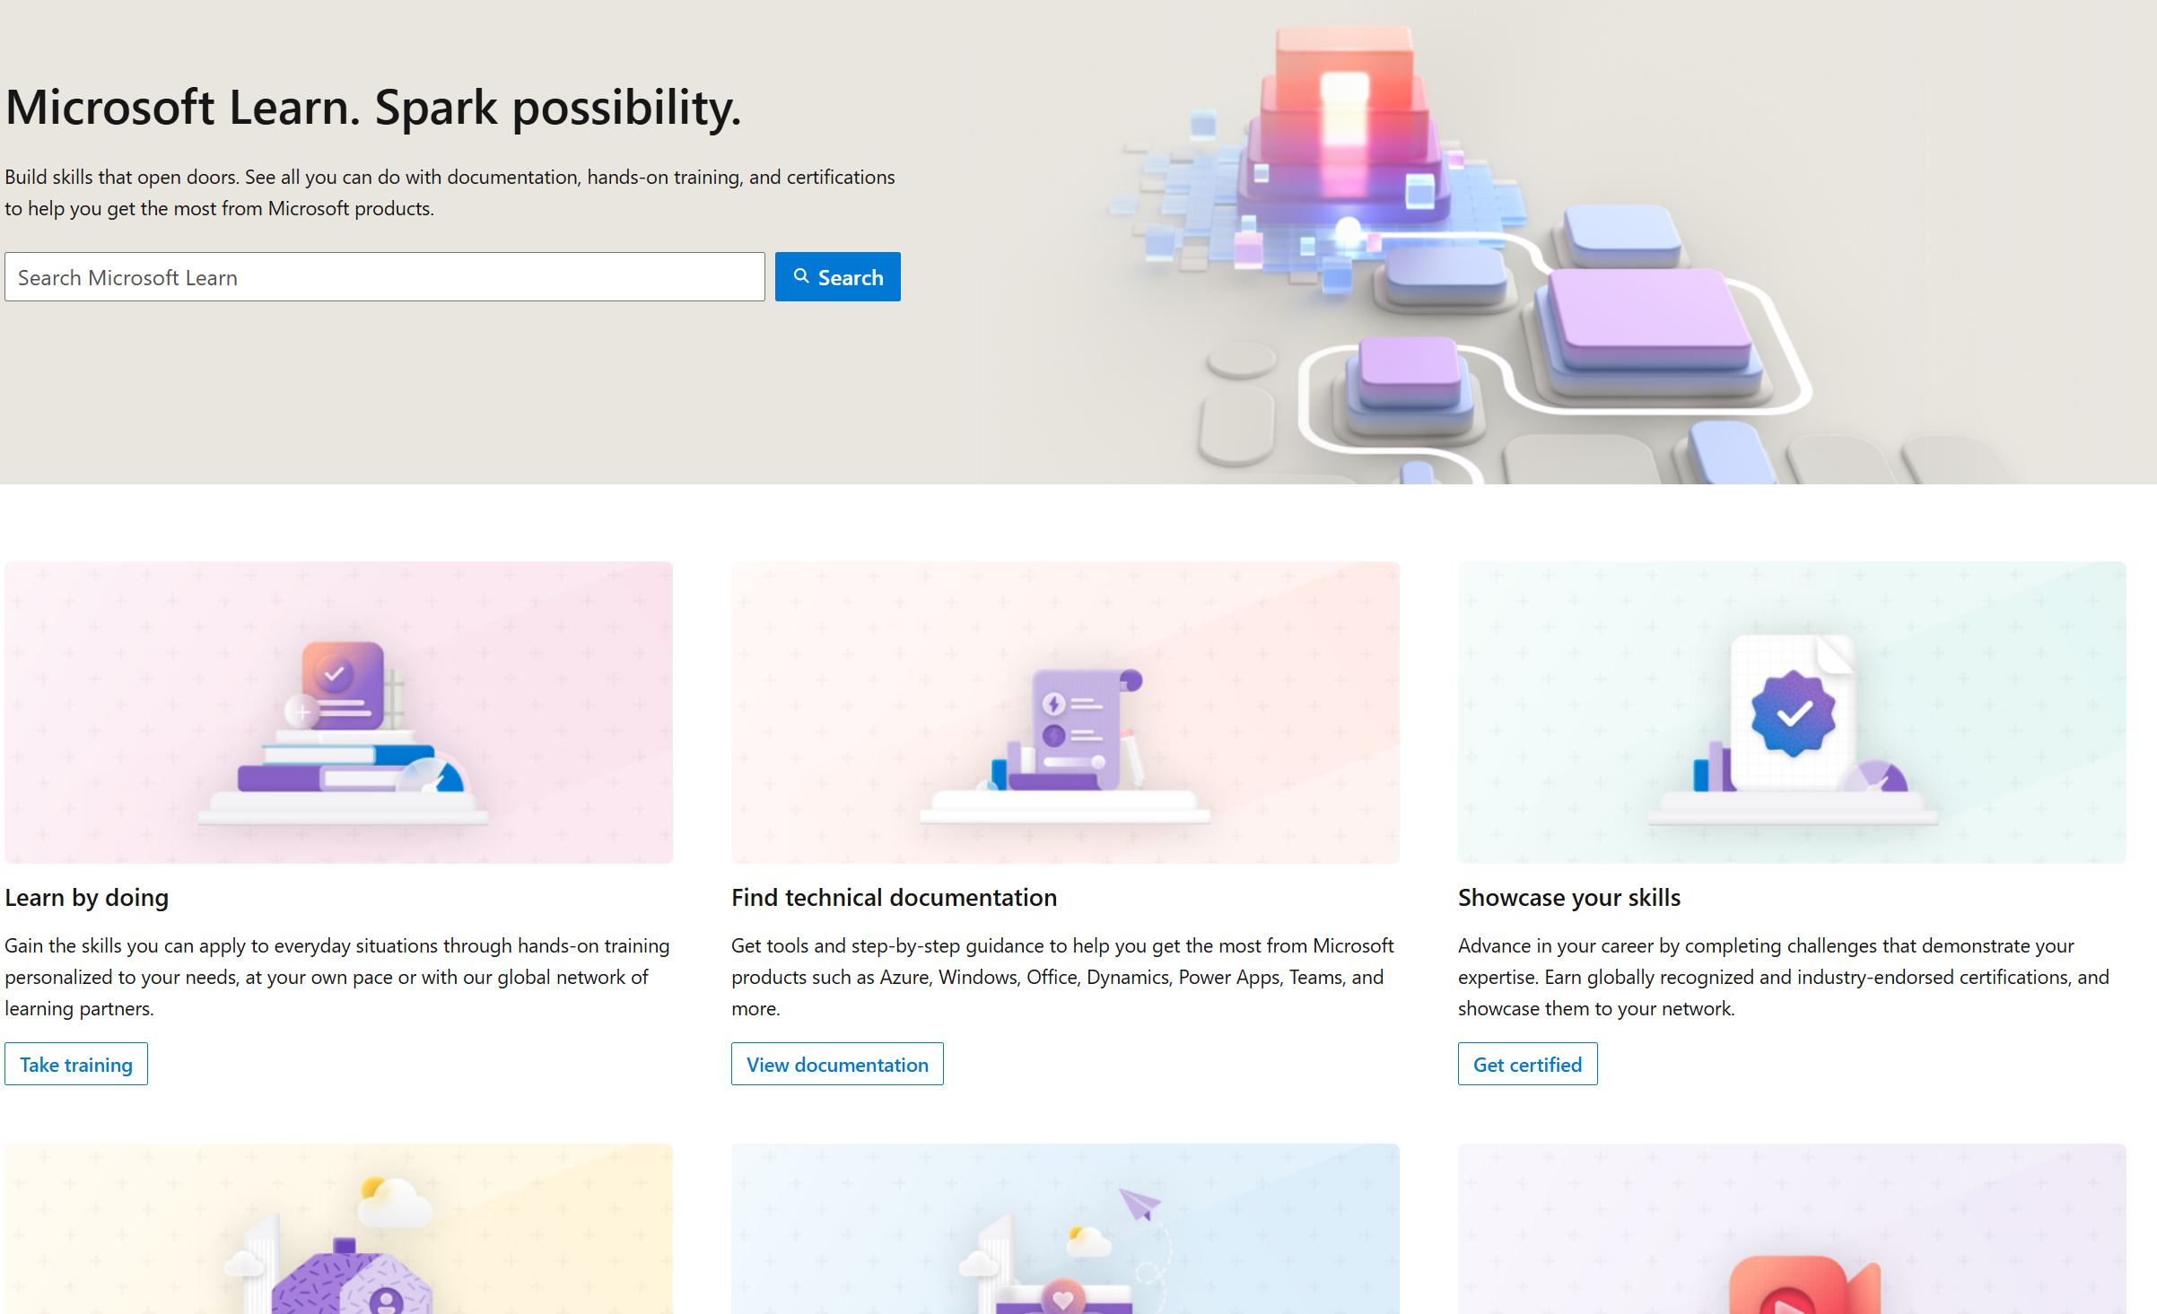
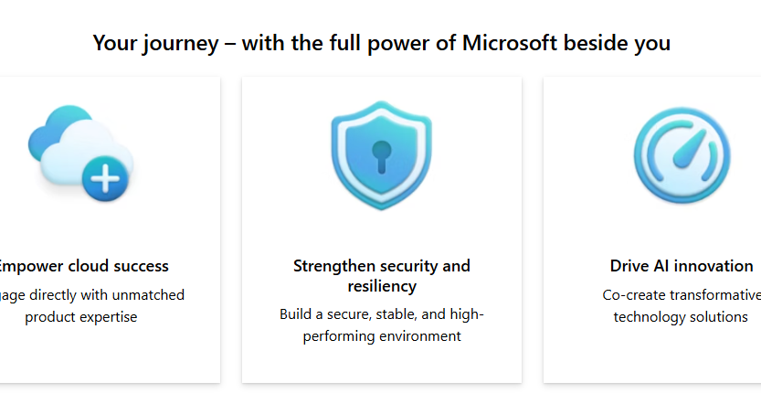
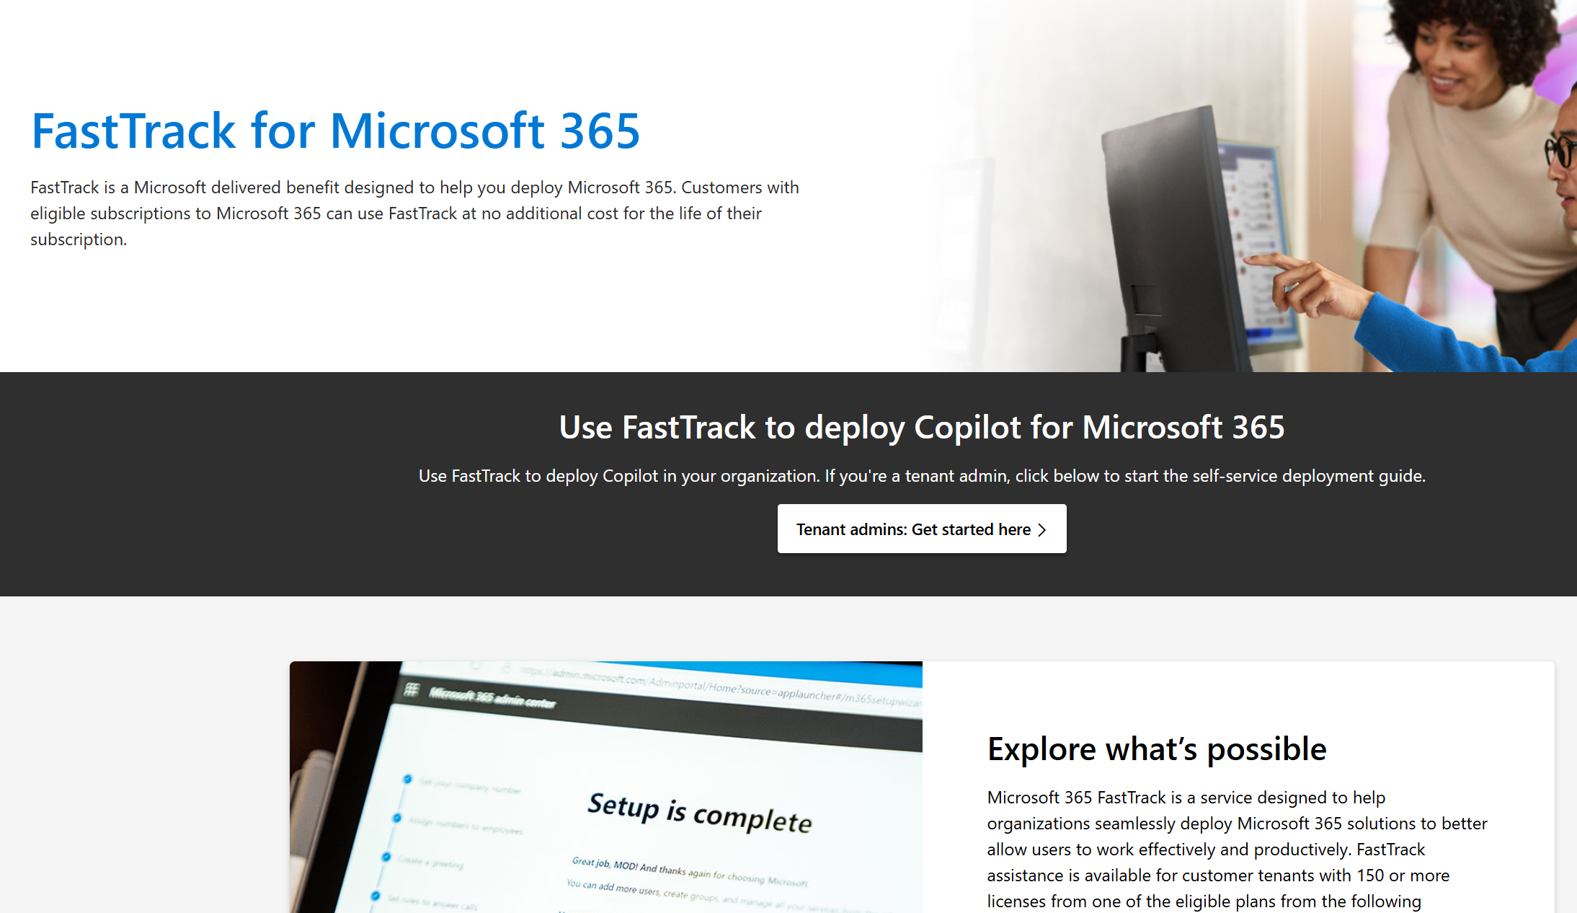
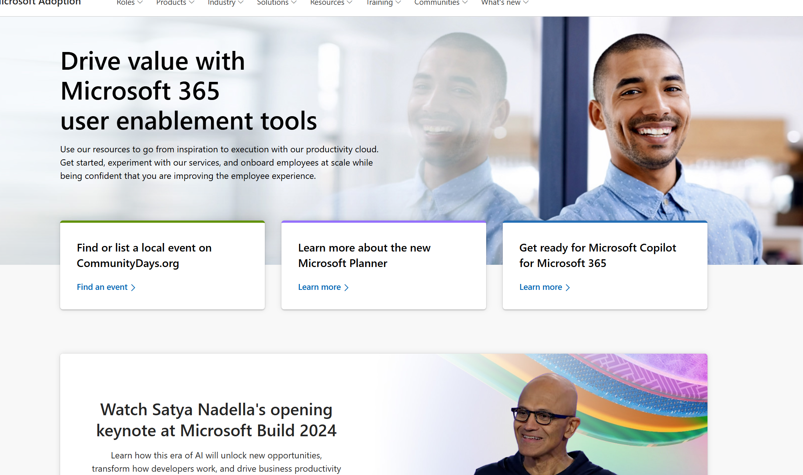
Copilot for Microsoft 365
Readiness checklist and key resources
Get ready
Onboard & engage
Deliver impact
Extend & optimize
Secure exec sponsorship, create AI Council, and define RAI principles
Identify success owners, Champions, and early adopter cohorts
Detail high value scenarios and personas
Be intentional with assignment and concentrate seats
Define success criteria, KPIs, and success measurement plan
Complete User Enablement Strategy training
Design and deploy training and engagement community (Center of Excellence/Champion Platform)
Launch employee communications and Champion program
Onboard executives and user cohorts
Deliver user Champions and support staff training
Review success measures and user survey results
Conduct feedback and reporting analysis
Deliver extended training and adoption support
Identify additional optimization scenarios
Iterate user experience strategy
Gather and amplify success stories
Extend to new high value scenarios
Deliver business process transformation with Copilot Studio, plugins and connectors
Drive group and cross-organizational productivity and innovation
Understand custom line of business opportunities
User Enablement
Support continuous learning and optimization
Microsoft Learn
Build your skills across Microsoft products and services with industry leading online training and certification programs.
Microsoft Unified
Unified unlocks the greatest value from your investment.
Microsoft FastTrack
FastTrack is a Microsoft delivered benefit designed to help you deploy Microsoft 365.
Microsoft resources
Microsoft Adoption
Resources to ensure you are delivering employee satisfaction and business value. Accelerate human change management with on-line resources, training and communities to make the most of your investment, all included with your subscription.
Notes:
Get ready is the first phase for any organization. Making sure that the business has secured sponsorship and identified individuals within the organization who are responsible for success as well as early adopters. Early adopters are users who are given access to Copilot ahead of a broader deployment and can be individuals who are particularly welcoming of change (or trying new technology) or can be groups of individuals where a specific use case or business scenario has been identified that can benefit from the use of Copilot. They are generally considered what is commonly known as ‘friendly users’ – typically they will provide constructive feedback directly to the project or program team and are more understanding of the fact that they are an early adopter.
It is beneficial at the earliest opportunity to identify specific (and high value) use cases where the organization can quickly realize value from the use of copilot. This is generally achieved with ‘intentional’ assignment of licensing based on a specific use case or business requirement.
Crucial to the success of your product launch at the outset is to clearly define your success criteria, KPI’s (key performance indicators) and how you will measure success. These outcomes are a necessary factor and will help to ensure that you have the full support of the business as you move into a broader deployment
At the onboarding and engaging phase, think about how you will manage training and communications and the broader engagement with your users. Think about how that training will be delivered, how that training will also be inclusive, relevant to the business requirements and is updated to reflect changes and improvements as Copilot continues to develop.
Having senior leaders and executives aligned at the early stages with a strong focus on training will reassure users of the commitment from the organization.
Delivering impact is determining how to gather and look at user feedback and how to manage and respond to that feedback. It’s also about how do you collect users’ individual success stories, or “a ha” moments, and share them broadly with the organization.
Expand and optimize phase is where you start thinking about extending to new, high value or cross-organizational scenarios, such as creating custom agents with Copilot Studio.

Slide 7

Role of the Mentor
Notes:
In this segment, we will examine the vital role of mentors in supporting AI transformation within organizations.
We will explore their (your) responsibilities in knowledge transfer, motivation, and the importance of a 'people first' strategy.

Slide 8

The Role of the Mentor in AI Transformation
Guidance Through Complexity
Mentors provide essential guidance in navigating the complexities involved in adopting AI technologies effectively.
Facilitating Understanding
They facilitate understanding of AI concepts, making it easier for individuals to grasp and implement new technologies.
Encouraging Innovation
Mentors foster a culture of innovation within organizations, inspiring individuals to explore creative solutions through AI.
Notes:
Mentors play a crucial role in the successful adoption of AI technologies within organizations.
They help individuals navigate the often complex landscape of AI, ensuring that teams can effectively implement these innovations.
By breaking down intricate concepts, mentors make it easier for everyone to understand and engage with AI.
Additionally, they cultivate an environment that encourages creativity and experimentation, which is vital for driving innovation.
The visual elements on this slide, featuring figures with magnifying glasses and light bulbs, symbolize the search for insight and the generation of new ideas, reinforcing the importance of mentorship in fostering a culture of exploration and growth in AI. ______
Guidance Through Complexity
Example:
A mentor supports a cross-functional team that’s overwhelmed by the scope of Copilot features.
The mentor breaks down the transformation into manageable phases — starting with basic email summarization and document drafting — then gradually introduces more complex use cases like automating project reports.
They create a simple roadmap and offer weekly drop-in sessions to reduce uncertainty and build confidence.
Facilitating Understanding
Example:
A mentor hosts a “Lunch & Learn” series, where they explain AI concepts in non-technical language — such as how Copilot uses organizational data to personalize results or why clear prompting improves output.
They use analogies, hands-on demos, and encourage questions.
Participants leave each session with one new use case they can try immediately.
Encouraging Innovation
Example:
The mentor launches an “AI Idea Board” on Microsoft Teams, where colleagues can post problems they’d like Copilot to solve (e.g., “I spend too long creating presentations.”).
The mentor encourages the team to co-develop prompts and test creative Copilot workflows — like turning meeting notes into PowerPoint slides — sparking a sense of ownership and experimentation.

Slide 9

Responsibilities: Knowledge Transfer, Motivation, Support
Knowledge Transfer
Mentors are responsible for sharing their expertise and knowledge about tools like Microsoft 365 Copilot to facilitate learning.
Motivation
A mentor's role includes motivating team members to embrace technology and encouraging them to explore new possibilities.
Ongoing Support
Providing continuous support throughout the learning journey is essential for mentors to help their mentees succeed.
Notes:
In addition, Mentors play also a crucial role in fostering a culture of learning and innovation within teams.
Their primary responsibility is knowledge transfer, which involves sharing insights and expertise about tools like Microsoft 365 Copilot.
This not only enhances individual skills but also promotes collective growth.
Additionally, motivation is key; mentors should inspire team members to embrace new technologies and explore their potential.
This encouragement can lead to greater engagement and creativity. Lastly, ongoing support is vital throughout the learning journey.
Mentors must be available to assist and guide their mentees, ensuring they feel confident and capable as they navigate new challenges.
The visual representation of collaborative learning emphasizes the importance of teamwork in this process.

Slide 10

The 'People First' Strategy
Prioritizing Employee Needs
A 'people first' strategy focuses on understanding and addressing the needs of employees during technological transitions.
Fostering Inclusivity
This approach promotes an inclusive environment where all voices are heard and valued during the change process.
Acceptance of Change
By prioritizing employees, organizations can foster acceptance and reduce resistance to AI technologies.
Notes:
“As we explore the integration of AI technologies like Microsoft 365 Copilot, it’s crucial to ground our efforts in a ‘People First’ strategy.
That means we don’t start with the tech — we start with our people.”
1. Prioritizing Employee Needs
“Technological transitions often feel overwhelming.
A people-first mindset asks:
What do our employees need to succeed?
What concerns might they have?
By listening actively and addressing those needs — whether it’s upskilling, clarity, or reassurance — we create a more supportive environment for change.”
2. Fostering Inclusivity
“This strategy also ensures that everyone has a voice in the journey.
From early adopters to hesitant users, we invite feedback, recognize different learning curves, and build a sense of shared ownership. AI adoption is not just an IT project — it’s a cultural shift, and inclusion is non-negotiable.”
3. Acceptance of Change
“When people feel seen, heard, and equipped — they’re far more likely to embrace change.
This is how we reduce resistance and turn uncertainty into opportunity. With Copilot, for example, showing early how it helps with daily tasks — not replaces roles — can build both trust and enthusiasm.”
“In short, ‘People First’ isn’t just a strategy — it’s the foundation for sustainable, human-centered innovation.”

Slide 11
Trust and Leadership in the AI Era
Notes:
Building trust in new technologies is essential for successful adoption. This section will discuss key strategies for leaders and mentors to cultivate trust within their teams and organizations.

Slide 12

How to Build Trust in New Technologies
Transparency in Technology
Being transparent about the capabilities and limitations of new technologies fosters trust among team members and stakeholders.
Engaging Team Members
Actively engaging with team members helps to build rapport and encourages a collaborative environment for technology adoption.
Encouraging Feedback
Encouraging open feedback allows for continuous improvement and enhances trust in new technologies among users.
Notes:
Building trust in new technologies is crucial for successful adoption.
Transparency is the first step; by openly discussing what these technologies can and cannot do, you need to create a foundation of trust with your team and stakeholders.
Next, engaging team members actively not only fosters rapport but also encourages a sense of ownership in the technology adoption process.
This collaboration can lead to more innovative solutions and a smoother transition.
Lastly, encouraging feedback is essential.
It allows users to voice their experiences and concerns, which can drive continuous improvement and reinforce trust.
The image of individuals discussing technology underscores the importance of communication in this process.

Slide 13

Role Model and Communication
Embracing New Technologies
Leaders should demonstrate a positive attitude towards adopting new technologies, serving as role models for their teams.
Effective Communication
Communicating the benefits of tools like Microsoft 365 Copilot can reduce anxiety and build excitement among team members.
Fostering Enthusiasm
Encouraging enthusiasm for new technologies can improve team morale and increase productivity in the workplace.
Notes:
Leaders, and that’s what you are, play a crucial role in the successful adoption of new technologies within their teams.
By demonstrating a positive attitude towards innovations like Microsoft 365 Copilot, they not only set an example but also inspire their teams to embrace change.
Effective communication is key; by clearly articulating the benefits of these tools, leaders can alleviate concerns and foster excitement among team members.
This approach not only reduces anxiety but also encourages a culture of enthusiasm, which is vital for enhancing team morale and productivity.
As we move forward, let’s focus on how we can cultivate this positive environment and leverage technology to its fullest potential. ______
Example: New Technologies
As a leader or mentor, you start a team meeting by showcasing a real example of how you used Microsoft 365 Copilot to streamline your own tasks — such as drafting a monthly report in Word using natural language, summarizing lengthy email threads in Outlook, or preparing a Teams update based on project notes.
You then encourage the team members to try similar use cases and openly share successes or struggles. By consistently integrating Copilot into your own workflow and making that visible, you lead by example and signal that it’s safe — and valuable — to experiment with AI in daily work.
Example: Effective Communication
Introduces Microsoft 365 Copilot during a meeting by explaining its purpose in clear, relatable terms:
“Copilot is like having an assistant built into the apps you already use — Word, Excel, Teams. It won’t replace your expertise, but it can help you write faster, summarize meetings, or generate first drafts so you have more time for real thinking.”
Then share a short demo of Copilot summarizing a recent Teams conversation, followed by an open Q&A.
They actively address concerns about AI accuracy or job impact with honest, supportive responses, emphasizing that Copilot is a tool to empower—not replace—employees.
Would you like a few ready-to-use phrases or slides to help communicate these benefits in your own sessions?
Here’s a strong example for Fostering Enthusiasm in the context of Microsoft 365 Copilot:
Example: Fostering Enthusiasm
Ask your manager to launch a “Copilot Challenge” within the team: Each team member is encouraged to try Copilot once a day for a week — whether to write a summary, draft an email, or create a to-do list from meeting notes.
At the end of the week, they hold a short virtual “Copilot Coffee Break” where everyone shares their favorite prompt or outcome. The manager highlights creative uses, celebrates small wins, and offers a prize (like a coffee voucher) for the most innovative use case.
This playful, low-pressure environment builds curiosity and excitement, turning Copilot adoption into a shared learning journey instead of a top-down directive.
Would you like a template or guide for setting up a similar Copilot Challenge for your participants or clients?

Slide 14
Training & Support Strategies
Notes:
This section focuses on effective training and support strategies to ensure successful implementation of Microsoft 365 Copilot. We'll explore practical applications and provide a live demonstration.

Slide 15

Microsoft 365 Copilot in Practice
Enhancing Daily Workflows
Microsoft 365 Copilot can streamline daily tasks, making workflows more efficient and reducing time spent on repetitive activities.
Boosting Collaboration
By facilitating real-time collaboration, Microsoft 365 Copilot helps teams work together seamlessly across different applications and devices.
Integrating Applications
Microsoft 365 Copilot integrates various applications, allowing users to transition smoothly between tasks and tools for increased productivity.
Notes:
Microsoft 365 Copilot is designed to enhance productivity in several keyways.
First, it significantly improves daily workflows by automating repetitive tasks, allowing users to focus on more strategic activities.
This efficiency not only saves time but also reduces the cognitive load on employees.
Second, the tool fosters collaboration by enabling real-time communication and teamwork across various applications and devices, ensuring that team members can work together seamlessly, regardless of their location.
And lastly, its ability to integrate multiple applications means users can switch between tasks effortlessly, which further enhances productivity. Overall, Microsoft 365 Copilot is a powerful ally in modern work environments, streamlining processes and promoting effective collaboration.
Let me give you an example for each area:
Example:Enhancing Daily Workflows
A project coordinator uses Microsoft 365 Copilot in Word to automatically draft project status reports based on meeting transcripts from Teams and notes in OneNote.
Instead of manually copying and summarizing content, Copilot produces a structured draft that only needs fine-tuning — saving 1–2 hours per report.
Example: Boosting Collaboration
A marketing team uses Copilot in Microsoft Teams during campaign planning meetings.
After the call, Copilot summarizes the discussion, extracts key action items, and shares the summary in the team chat.
Everyone is instantly aligned, even those who couldn’t attend — reducing misunderstandings and duplicate work.
Example: Integrating Applications
A sales representative uses Copilot in Outlook to analyze a customer email thread, then asks Copilot to summarize key points and generate a follow-up proposal draft in Word.
Without switching tabs or losing context, they move from communication to content creation in one seamless flow.

Slide 16

Use Cases (Outlook, Word, Teams, Excel)
Streamlining Tasks
Microsoft 365 Copilot can automate repetitive tasks in applications, reducing time spent on manual inputs.
Improving Efficiency
By integrating Copilot, users can enhance their productivity with intelligent suggestions and quick access to information.
Collaboration in Teams
Copilot facilitates better collaboration in Teams by summarizing discussions and tracking action items effectively.
Data Insights in Excel
With Copilot, Excel users can generate data insights and visualizations, aiding in better decision-making.
Notes:
Find out, what are your usecases for your organization, here are just a couple

Slide 17

Demo: Experience Copilot Live
Hands-On Experience
Participants will engage in a live demo, allowing them to experience Microsoft 365 Copilot in real-time.
Interactive Session
Sessions are designed to be interactive, encouraging questions and exploration of Copilot's features.
Tool Features and Capabilities
Demo will showcase key features and capabilities of Microsoft 365 Copilot, enhancing productivity, tailored to your organization.
Notes:
Demo Goals
Provide real-time experience with Microsoft 365 Copilot
Explore core featuparticipants to apply Copilot in their daily work
Foster interaction and experimentation
res across multiple M365 apps
Inspire
Tips for Engagement
Ask: “What part of your work could Copilot simplify?”
Use a virtual whiteboard or Miro to collect ideas live
Offer a QR code or link for feedback or prompt-sharing
Let participants vote on what they want to see Copilot do next
https://bellshosting-my.sharepoint.com/:w:/r/personal/markus_bells_at/Documents/Documents/Trainer%20Files/Copilot%20Trainings/GEA%20-%20Copilot%20Individuell/Kurs%201/Demo%20-%20Experience%20Copilot%20Live.docx?d=w819ea5a75d0d4f259ce295eb0068d2aa&csf=1&web=1&e=RHyKyU

Slide 18
Creating Effective Prompts
Notes:
In this section, we will learn about crafting effective prompts that enhance interaction with Microsoft 365 Copilot. Understanding prompt structure can significantly improve user experience.

Slide 19

Prompt Formula: Role, Goal, Context
Defining the Role
Clearly defining the role is essential for guiding the responses you receive from Copilot. It sets the framework for the interaction.
Clarifying the Goal
Clarifying the goal helps to focus the responses you get, ensuring they align with your intended outcomes for the interaction.
Providing Context
Providing context is crucial for achieving meaningful responses, as it gives background information necessary for understanding your request.
Notes:
Understanding the prompt formula is key to optimizing your interactions with Copilot.
Start by clearly defining the role you want Copilot to assume; this sets the stage for the type of responses you can expect.
Next, clarifying your goal is essential—it ensures that the answers you receive are aligned with your specific objectives.
Finally, providing context enriches the interaction by offering background information that helps Copilot understand your request more deeply.
The visual of a hand drawing an atom symbolizes the foundational elements of this formula, illustrating how these components come together to create a more effective dialogue with the AI.

Slide 20

Examples & Prompt Handout
Effective Prompt Examples
Participants will be provided with examples of effective prompts that demonstrate best practices for Microsoft 365 Copilot.
Prompt Handout
A handout can be distributed that serves as a reference guide for creating prompts efficiently.
Notes:
“Now, we’ll explore what makes a prompt truly effective in Microsoft 365 Copilot.
Good prompts are clear, contextual, and goal-oriented.
They help Copilot deliver accurate and useful outputs — whether it’s drafting an email, summarizing a meeting, or analyzing campaign data. I’ll show you several best-practice examples, and you’ll get a handout that you can use as a cheat sheet for your daily work.
These are not just tips — they’re real-world, tested prompts that our teams use in Marketing, HR, and Finance.
As we go through them, think about your own workflows and how you could adapt or reuse these prompts.
And don’t worry — we’ll also do a short activity where you’ll craft your own prompt with support from this guide.”
🧠 Example Prompts (Marketing Focused)
Use Case
Effective Prompt
Why It Works
Email Drafting
“Write a follow-up email to webinar attendees. Highlight the main takeaways, include the link to the replay, and add a CTA to schedule a call.”
Clear structure, context, and tone guidance
Report Summary
“Summarize this month’s email marketing performance from Excel sheet: focus on open rate, CTR, and conversion trends.”
Tells Copilot where to look and what to prioritize
Brainstorming Campaigns
“List 5 creative campaign ideas for a product launch targeted at Gen Z on Instagram and TikTok.”
Audience, platform, and purpose defined
Meeting Notes
“Summarize key points and action items from the meeting transcript. Format it as a bulleted list.”
Instructional and specific formatting hint
Competitor Comparison
“Compare our Q1 campaign performance with Competitor X using available LinkedIn data. Highlight what we did better and worse.”
Context-driven and asks for analytical depth
📌 Key Ingredients for a Good Prompt:
Context – What is the task or goal?
Source – Where is the data or input coming from?
Clarity – Use simple, direct language.
Tone / Format – Specify if needed (e.g., “bullet points,” “professional tone”).
Expectation – What exactly do you want Copilot to do?
🧾 🧰 Pro Tips:
Start with a verb: “Summarize…”, “Generate…”, “Create…”
Use natural language — speak to Copilot as you would to a colleague.
If results aren’t great: iterate! Small tweaks can improve outputs dramatically.
Save and reuse your best prompts — consistency matters!

Slide 21

Copilot and What else?
Notes:
What Are They?
Copilot Agents are custom-built AI assistants created using Copilot Studio to automate specific tasks, answer questions, or guide users through processes within Microsoft 365.
Key Features
Conversational AI tailored to business needs
Integration with internal systems and data sources
Low-code customization with a user-friendly interface
Security and compliance aligned with Microsoft standards
Use Cases
Automating HR FAQs
Guiding employees through IT support
Helping marketing teams retrieve campaign data
Streamlining onboarding or internal processes
Benefits
✅ Increases productivity
✅ Reduces repetitive tasks
✅ Enhances self-service and user satisfaction
Would you like this formatted into a PowerPoint slide?

Slide 22
Copilot Agents
Key Features
Conversational AI tailored to business needs
Integration with internal systems and data sources
Low-code customization with a user-friendly interface
Security and compliance aligned with Microsoft standards
Use Cases
Automating HR FAQs
Guiding employees through IT support
Helping marketing teams retrieve campaign data
Streamlining onboarding or internal processes
Benefits
Increases productivity
Reduces repetitive tasks
Enhances self-service and user satisfaction
Notes:
What Are They?
Copilot Agents are custom-built AI assistants created using Copilot Studio to automate specific tasks, answer questions, or guide users through processes within Microsoft 365.
Key Features
Conversational AI tailored to business needs
Integration with internal systems and data sources
Low-code customization with a user-friendly interface
Security and compliance aligned with Microsoft standards
Use Cases
Automating HR FAQs
Guiding employees through IT support
Helping marketing teams retrieve campaign data
Streamlining onboarding or internal processes
Benefits
✅ Increases productivity
✅ Reduces repetitive tasks
✅ Enhances self-service and user satisfaction
Would you like this formatted into a PowerPoint slide?

Slide 23
Copilot Studio
Interface Introduction
The Copilot Studio interface is designed for ease of use, enabling users to navigate effortlessly through its features.
Functionality Highlights
Key functionalities of Copilot Studio allow users to create prompts efficiently and enhance the overall user experience.
Enhanced User Interaction
The studio's design focuses on maximizing user interaction, making it easier to engage with the platform and its tools.
Notes:
“Let’s take a moment to look at the Copilot Studio interface, which is designed with simplicity and productivity in mind.
Whether you’re a business user or a technically inclined power user, the layout ensures that you can easily navigate and start building intelligent agents without deep coding knowledge.
At the top, you’ll find a clean navigation bar giving you access to all major functions – Topics, Entities, Analytics, and Settings.
The central workspace is where the magic happens – you can build conversations visually, drag and drop elements, and define actions.
Now, what makes the interface especially powerful is how functionality supports creativity:
You can connect to Power Automate, SharePoint, or external APIs directly. You can use predefined templates to get started quickly, and the built-in test bot panel allows you to validate your logic in real-time.
The user-centric design also encourages experimentation – you’re encouraged to test, iterate, and refine prompts and workflows, which is crucial in building a reliable Copilot agent.”

Slide 24

Demo: Copilot Agents & Studio

Slide 25
Tips for Introducing Copilot in the Organization
Notes:
In this section, we will discuss essential tips for successfully introducing Microsoft 365 Copilot in your organization, including governance, communication, and pilot group strategies.

Slide 26

Resources for Enablement
Training Modules
Training modules provide structured learning opportunities that help participants acquire essential skills for the rollout process.
User Guides
User guides offer detailed instructions and information that assist participants in effectively utilizing the resources provided.
Support Channels
Support channels are available to provide assistance and address any questions or issues that arise during the rollout process.
Notes:
Talking Track – Resources for Enablement
“Enabling users during the Copilot rollout requires more than just access — it requires structured support.
That’s why enablement resources are a core part of our strategy.
On this slide, we focus on three critical types of resources: training modules, user guides, and support channels.”
1. Training Modules
“First, we provide structured training modules.
These aren’t just quick overviews — they’re designed to walk participants step by step through Copilot’s features and use cases.
Whether it’s drafting emails, summarizing documents, or automating tasks, these modules help users build confidence and capability at their own pace.”
2. User Guides
“Next, we offer practical user guides. These documents give clear, scenario-based instructions — often with screenshots, prompt examples, and best practices — to help users solve real problems.
Guides are a go-to reference, especially when people want to revisit or deepen their skills after a training session.”
3. Support Channels
“Finally, we emphasize active support channels.
Whether it’s a dedicated Teams space, a helpdesk, or access to mentors or champions, people need to know where to turn when questions arise.
These channels ensure no one is left behind during the transition and that help is available just-in-time.”
“When we combine these resources — structured learning, reference materials, and real-time support — we create an enablement ecosystem that empowers every user to thrive with Copilot.”

Slide 27

User Enablement Guide, Templates, Training Modules
Comprehensive User Guide
The user enablement guide serves as a vital resource for both individuals and teams, enhancing their learning experiences.
Learning for Mentors
User Enablement in Viva
Templates for Learning
Templates included in the guide are designed to streamline processes and foster effective learning within teams.
Copilot Chat Tools and Templates
Top 10 to try
Prompt ingredients
Training Modules
Training modules provide structured content that supports ongoing education and skills development for users.
Copilot Virtual Skilling Event Framework
Copilot Daily Scenarios
Scenario Library
Notes:
To ensure the successful adoption of Microsoft 365 Copilot, we need more than just access to the technology — we need strong enablement tools that empower users, mentors, and entire teams.
This is where the User Enablement Guide, learning templates, and training modules play a crucial role.
Comprehensive User Guide
The User Enablement Guide is a vital resource supporting both individuals and teams.
It’s not just about explaining what Copilot can do; it’s about helping people understand how to apply it in their daily work.
From quick-start guidance to advanced usage tips, this guide provides practical, sustainable learning.
Learning for Mentors
Viva Integration
Templates for Learning
Templates within the guide streamline onboarding and learning across teams.
They help standardize how Copilot is introduced and practiced.
Copilot Chat Tools and Templates: Help users become fluent in natural language interactions with Copilot.
Top 10 Prompts to Try: Provide quick, powerful use cases across Word, Excel, Outlook, and Teams.
Prompt Ingredients: Break down prompt creation into components (goal, context, tone, constraints) for better results.
Training Modules
Structured training modules provide self-paced, role-based education that supports both onboarding and long-term capability building.
Copilot Virtual Skilling Event Framework: A ready-made framework to run your own interactive skilling events.
Copilot Daily Scenarios: Showcase how Copilot can support day-to-day work, making learning relatable and actionable.

Slide 28

Demo: Using provided tools
Notes:
Go here:
https://bellshosting-my.sharepoint.com/:w:/r/personal/markus_bells_at/Documents/Documents/Trainer%20Files/Copilot%20Trainings/GEA%20-%20Copilot%20Individuell/Kurs%201/Demo%20-%20Using%20provided%20tools.docx?d=w29d939ae1c70436991fcaffa1ece1359&csf=1&web=1&e=NpDe6T
and
https://bellshosting-my.sharepoint.com/:f:/r/personal/markus_bells_at/Documents/Documents/Trainer%20Files/Copilot%20Trainings/GEA%20-%20Copilot%20Individuell/Kurs%201/Microsoft-365-Copilot_Virtual-Skilling-Event-Framework-kit?csf=1&web=1&e=MLix8e

Slide 29
Sharing & Developing Knowledge
Notes:
This session emphasizes the importance of sharing and developing knowledge within the organization. We'll explore ways to enhance prompt sharing and collective learning.

Slide 30
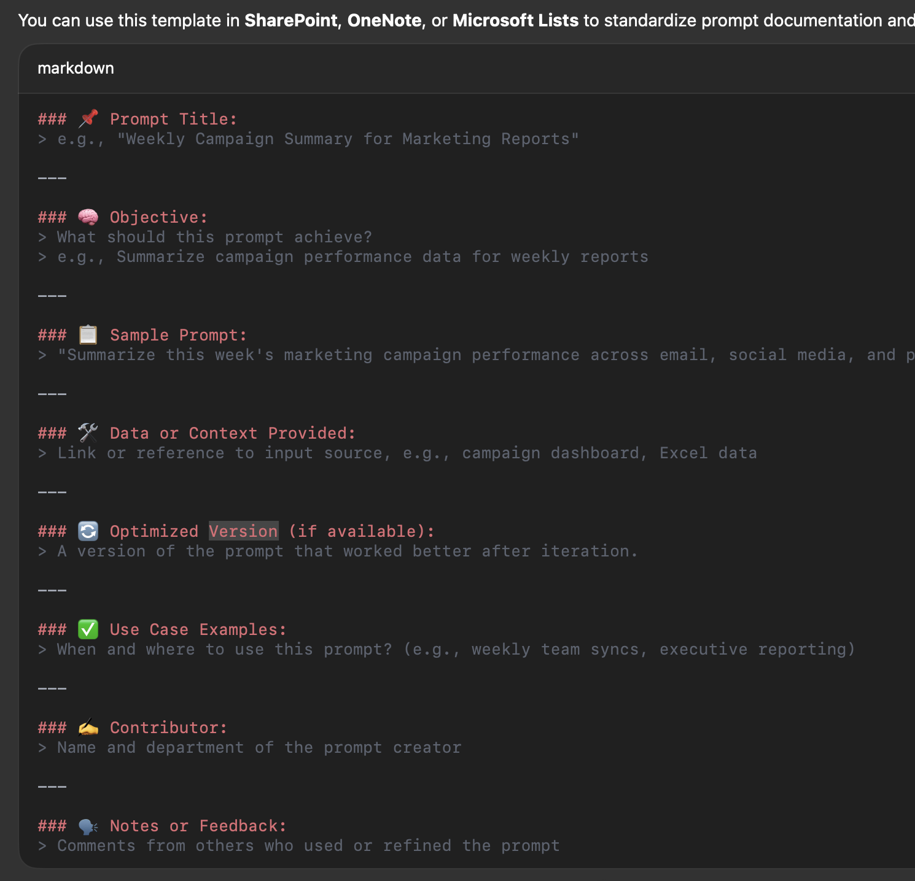
Prompt Sharing & Optimization
Importance of Sharing Prompts
Sharing prompts among team members enhances collaboration and leads to better outputs from Copilot.
Optimizing Prompts
Optimizing prompts is crucial for improving the quality and relevance of interactions with Copilot.
Enhanced Team Interaction
Effective prompt sharing and optimization foster enhanced interactions, leading to increased productivity.
Notes:
🎤 Talking Track – Prompt Sharing & Optimization
As mentors and key users, one of your most impactful roles is promoting the sharing and optimization of prompts.
This isn’t just about using Copilot — it’s about collaboratively improving how it’s used across the team.
🔹 Importance of Sharing Prompts
Sharing well-crafted prompts has immediate benefits:
It allows team members to reuse successful approaches, reducing duplication of effort.
It builds a shared knowledge base that helps others overcome initial learning curves.
It encourages cross-functional insights, where a marketing prompt might inspire a similar use in HR or operations.
🔁 Example:
A team member in marketing creates a prompt like:
“Summarize the key performance trends from our Q1 campaign data and suggest next steps for Q2.”
Sharing this in Teams or in a prompt library allows others to adapt it — for example, in sales:
“Summarize the top-performing accounts from Q1 and recommend follow-up actions for Q2.”
🔹 Optimizing Prompts
Effective prompts are rarely perfect the first time. Optimization involves:
Clarifying intent (What exactly do you want Copilot to do?)
Adding context (Include relevant data or background)
Refining tone and structure (e.g., formal report vs. action list)
⚙️ Example (Before vs. After):
Before:
“Create a campaign brief.”
After optimization:
“Create a 1-page campaign brief for a new product launch targeting Gen Z customers, including objectives, channels, timeline, and KPIs — in a professional tone.”
This clarity helps Copilot deliver higher-quality results consistently.
🔹 Enhanced Team Interaction
Sharing and optimizing prompts fosters a culture of collaboration:
It promotes peer learning — people learn by seeing how others phrase tasks.
It drives continuous improvement, as prompts get iteratively better.
It supports scaling knowledge, especially in larger teams or across departments.
Consider using:
Prompt libraries in SharePoint or OneNote
Dedicated Teams channels for “Prompt of the Week”
Workshops where teams co-develop and test prompts
Prompt sharing and optimization is not a technical task — it’s a collaborative habit.
When embraced across your team, it elevates how everyone interacts with AI and leads to real productivity gains.

Slide 31

Whiteboard Activity: Collecting Best Prompts
Collaborative Engagement
Participants will work together to contribute ideas, enhancing creativity and collaboration in prompt collection.
Refining Best Prompts
The activity encourages participants to refine and improve the prompts, ensuring they are effective and useful.
Continuous Improvement Culture
This collaborative effort fosters a culture of continuous improvement, essential for effective teamwork and innovation.

Slide 32

Conclusion & Outlook
Key Takeaways
Summarizing the main points discussed will help reinforce the value of Microsoft 365 Copilot in enhancing productivity.
Future Outlook
Discussing the future outlook for Microsoft 365 Copilot will shed light on its evolving role in workplace productivity.
Workplace Transformation
Highlighting the potential for transforming workplace productivity will inspire innovation and adaptation in organizations.
Notes:
--- We will summarize the key takeaways from today’s presentation and discuss the future outlook for Microsoft 365 Copilot, highlighting its potential for transforming workplace productivity. Image source: Microsoft 365 content library

Slide 33
What have you seen?
Trust, Enable
Empowerment through enablement, building trust, and providing hands-on practice.
Creating Effective Prompts
Defining the role, clarifying the goal, and providing context.
Role of the Mentor
Guidance, facilitating understanding of AI concepts, and encouraging innovation.
Sharing & Optimize Prompts
Importance of sharing prompts, optimizing prompts, and enhanced team interaction
Responsibilities
Sharing expertise, motivating team members, and ongoing support

Slide 34

FAQ

Slide 35

Appendix
Notes:
The appendix includes additional resources and information that participants can refer to after the presentation. This includes prompt examples, templates, and handouts.

Slide 36
Prompt Examples
Inspiration for Prompts
Explore various prompt examples that can inspire creativity and enhance productivity when using Microsoft 365 Copilot.
Effective Prompt Creation
Learn how to craft effective prompts that lead to better outcomes and more efficient usage of Microsoft 365 Copilot.
Utilizing Microsoft 365 Copilot
Understand the features of Microsoft 365 Copilot and how to use prompts to leverage its capabilities fully.
Notes:
--- This slide includes a collection of prompt examples that can be used as inspiration when creating prompts for Microsoft 365 Copilot. Image source: Microsoft 365 content library

Slide 37

Agent Template QR-Link
Access to Agent Templates
Participants will have access to various agent templates through a QR link, facilitating easy solution building.
Utilizing Microsoft 365 Copilot
The templates are designed to help users build tailored solutions using Microsoft 365 Copilot for enhanced productivity.
Notes:
--- A QR link will be provided to access agent templates that participants can utilize to build their own solutions with Microsoft 365 Copilot. Image source: Microsoft 365 content library

Slide 38

Handout Overview
How Microsoft implpements Copilot
Deploying Microsoft 365 Copilot with the help of—you guessed it—Copilot
Deploying Microsoft 365 Copilot internally at Microsoft
Ensuring all participants have easy access to necessary materials is crucial for effective learning and engagement.
Variety of Handouts
The presentation includes a variety of handouts tailored to different topics, allowing participants to explore further.
Notes:
--- This slide will provide an overview of various handouts that have been shared throughout the presentation, ensuring participants have access to all necessary materials. Image source: Microsoft 365 content library

